Slide 1
Identifying the best Moscow borough for bank departments
By MaRichev Ivan

Slide 2
Background
Moscow, one of the largest metropolises in the world with a population of more than 12 million people, covers an area of ​​more than 2561.5 km² with an average density of inheritance of 4924.96 people / km².
Moscow is divided into 12 districts (125 boroughs, 2 urban boroughs, 19 settlement boroughs).
Moscow has a very uneven population density from 30429 people / km² for the "Zyablikovo" borough, to 560 people / km² for the "Molzhaninovskij" borough.
The average cost of real estate varies from 68,768 rubles / m² for the "Klenovskoe" borough to 438,568 rubles / m² for the "Arbat" borough.

Slide 3
Business Problem
Owners of cafes, resturants, gym, bank department and other social facilities are expected to prefer boroughs with a high population density. Investors will prefer areas with low housing costs and low competitiveness. The key criteria for selecting suitable locations for new bank department will be: High population of the borough Low cost of real estate in the borough Venues in borough The main stakeholders of my research will be bank owner or key investors, interested in expanding the geography of the representative office.

Slide 4
Data acquisition and cleaning
Common data of Moscow boroughs was taken from gis-lab.info
Geographic data was added with Nominatim
Border of borough taken from Qis.com
Value of House pricing taken from mirkvartir.ru
Data about density of borough taken from Wikipedia.ru

Slide 5
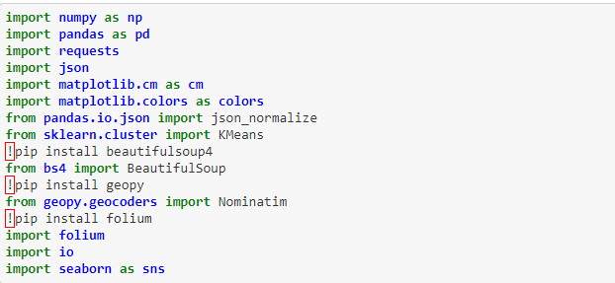
Step 0 – Import required libraries
For this work need to import all needed library

Slide 6
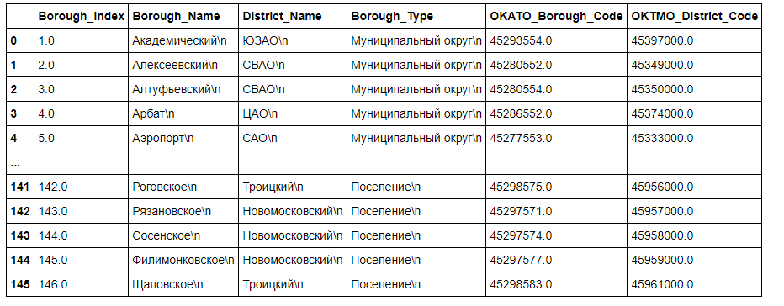
Step 1 – Get parsed data
Dirty, unprepared data – strongly needed to “wash” this dataset.

Slide 7
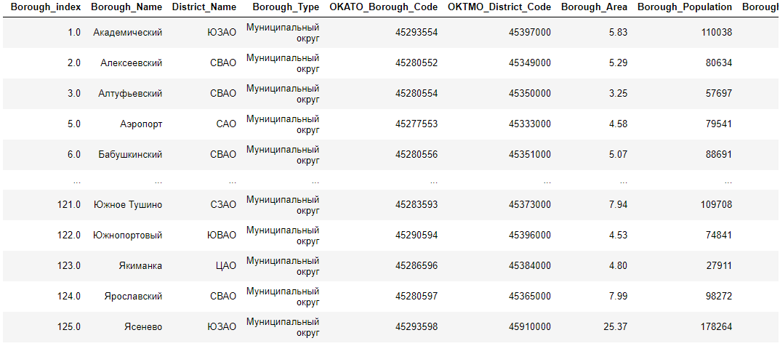
Step 2 – Get “cleaned” data
After all operation on dataset, in finally looking good for next operation

Slide 8
Step 3 – Get visualizing data
Need to admit – looking only in “text-number”- like data not so good idea. Added some visualizing of data
Visual part strongly depend on data we have, and on what exactly need to show.
For our cases perfect fit boxplot kind

Slide 9
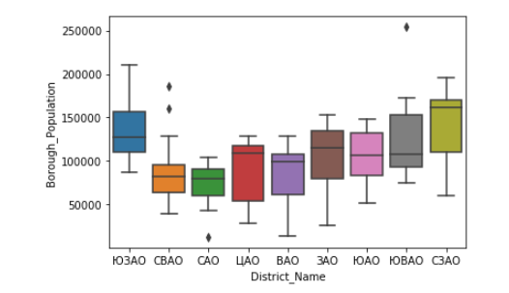
Population of borough

Slide 10
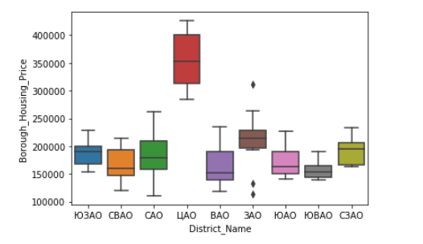
Housing price of borough

Slide 11
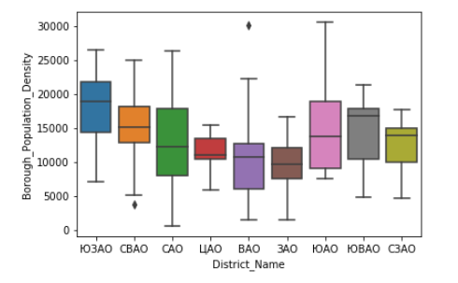
Population density of borough

Slide 12
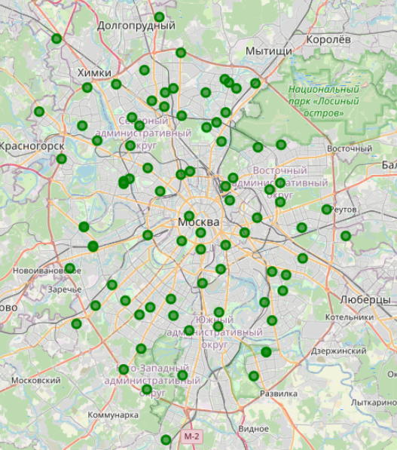
Map of Moscow with added location of borough

Slide 13
Step 4 – Using machine learning
For our business-purposes, segmenting borough of Moscow borough to identifying best place for new bank department, perfect fit k-mean – algorithm of machine learning clustering
K-mean working by placing few centroid in data, and finding revelationship between data, where is possible.
Result of using this method – see below

Slide 14
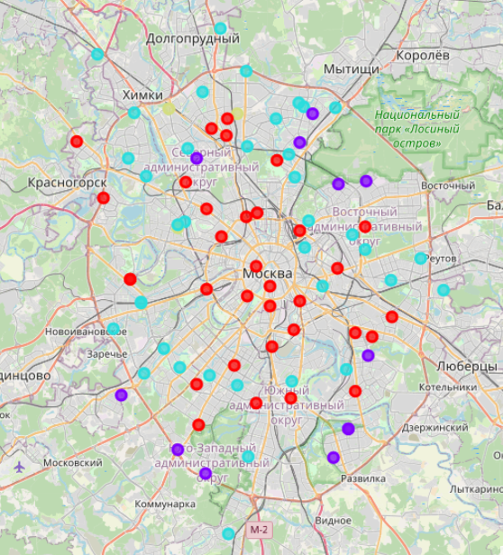

Slide 15
Conclusion and future directions
Purpose of my project was to identify the optimal places for the location of bank department in Moscow boroughs, taking into account the dencity of population, the cost of real estate and the density of other fitness facilities in order to aid stakeholders in narrowing down the search for optimal location for a new bank department.
Results provided by research can ease new investors to found out potentially best place for new a new bank department.

